Slide 1

On remote Temperature Sensing Using
UHF RFID
tags
K R Vadiraj
1DS16CS131

Slide 2
Abstract
With the ever-growing technological innovations of Radio frequency Identification (RFID) technology RFID based sensors have attracted great interest in the commercial market.
Due to the limitations of RFID tags, most existing RFID based temperature sensing works rely on hardware tweaks which result in the increase in costs and hampers large scale development in industries.
In this paper we propose RFThermometers, a remote temperature sensing system with commercial ultra-high-frequency (UHF) tags. We first investigate the affect of temperature on RFID phases.

Slide 3
Introduction
Widespread use in supply chain management,access control, card authorization and inventory tracking.
Advantages include low cost and commercial availability.
The drastic growth of Internet of Things (IoT) RFID systems have attracted great interest and use
Current RFID based temperature systems depend on modified RFID tags. General sensors can be embedded inside the tags to make it detect temperature ranges from (-40 to 80 degrees celsius). The main drawback is that these sensors could be only used at 134.2 kHz
To overcome this limitation we propose a system making use of UHF RFID tags

Slide 4
Literature Survey
Shao, Shuai, et al. “Broadband Textile-Based Passive UHF RFID Tag Antenna for Elastic Material.” IEEE Antennas and Wireless Propagation Letters, vol. 14, 2015.
Scherhaufl, Martin, et al. “UHF RFID Localization Based on Evaluation of Backscattered Tag Signals.” IEEE Transactions on Instrumentation and Measurement, vol. 64, no. 11, 2015.
Scherhaufl, Martin, et al. “Robust Localization of Passive UHF RFID Tag Arrays Based on Phase-Difference-of-Arrival Evaluation.” 2015 IEEE Topical Conference on Wireless Sensors and Sensor Networks (WiSNet), 2015.

Slide 5
Present Technology
To exploit the characteristics of tags using temperature some use paraffin wax as a substrate material for heat sensing
. Considering the physical properties of this substance the changes of this layer due to the effect of temperatures is irreversible even though the temperature of the tag can be brought back to normal. Thus does not serve the purpose.
Zannas et al also demonstrated the effect of temperature on the material characteristics of RFID tag.They propose that the relative permittivity of the antennas and the tags can be changed by temperature
To achieve optimization specific tags are essential. Therefore this supports the fact that there is a strong demand for a temperature estimation system using generic, low cost UHF RFID tags

Slide 6
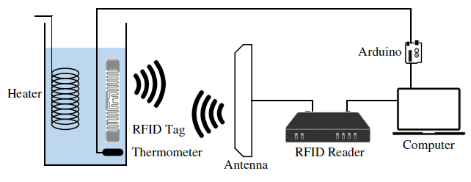
Proposal and contribution by the paper

Slide 7
This paper proposes to use unmodified commercial RFID tags for remote temperature sensing.
This system is cost-effective as it integrates advanced signal processing /machine learning algorithms such as tensor completion and Gaussian Process, to ensure high accuracy and robustness.
The testing environment consists of refrigerated warehouses and refrigerated retail display cases etc where the RFID tagged items are stationary against the RFID readers and antennas in most of the times

Slide 8
To avoid this problem slotted ALOHA based anti-collision protocols are used. The RFID tags operate on a large frequency range .
902~928 MHz in the US and is divided into 50 non-overlapping channels. Phase reading loss in a channel is inevitable in a complex environment.
The given tag interrogates tags with 50 channels in sequence and takes about 0.1 s in each channel. This means that it has to wait 5s to acquire the next set of information from the same channel.

Slide 9
The 2 main contributions of this paper are:-
1)Design of a gaussian process model to regress the relationship between phase and temperature as well as a DTW based greedy method.
2)Implementing a RFThermometer system with commercial RFID tags,antennas and readers.
The results by obtained solidify the robustness and flexibility of the proposed system

Slide 10

Preliminaries
Passive RFID chips are embedded into the tags which solely rely on backscattering to communicate with the readers.
The chip on the passive RFID tag harvests energy from the received interrogating signal sent by the reader
The power transmission coefficient is given by-
Where Rc,Zc,Ra and Za are the chip resistance and impedance , the antenna resistance and impedance respectively

Slide 11
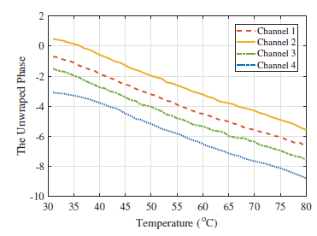
The power transmission coefficient reaches maximum when the chip impedance and antenna impedance are conjugately matched

Slide 12
Tensor Completion Preliminaries
Low Rank tensor-completion estimation is a sought after topic for research. It has mainly been used in fourier domain. Based on the t-product ,the t-svd of M is defined as
Where the size of the tensor is a1 x a2 x a3; u and v are orthogonal tensors of size a1 x a2 x a3 and a2 x a2 x a2 xa3
Series of matrix operations are applied to estimate the tensor values.

Slide 13
The RFThermometer system
In the proposed system, RFThermometer is a fingerprinting based remote temperature sensing system which operates on two stages online and offline respectively.
The FX9600 reader is able to collect phases from 50 channels within a period of 5 seconds .We denote data collected in one reading cycle as an observation which include phases collected from channel 1-50.
Because the dynamic environment and the number of tags, it is usually inevitable to lose phase readings in some channels therefore we use tensor completion algorithm.
We also use Multi linear Gaussian Process (MLGP) is also popular machine learning algorithm in data recovery

Slide 14
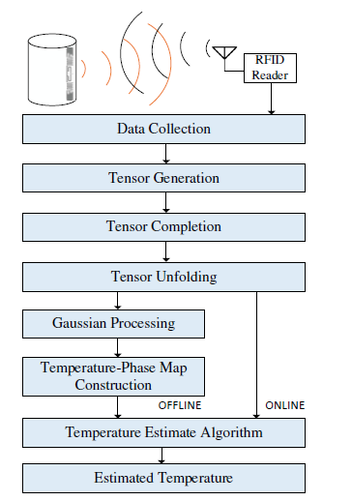

Slide 15
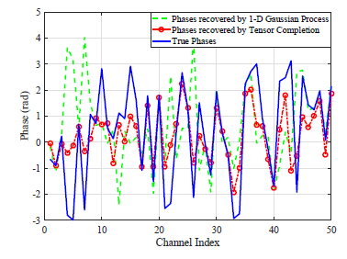
Thus the tensor completion is used in our RFThermometer system for
better precision of phase recovery.

Slide 16
Impact of Various Design Parameters
Impact of Tensor Completion Impact of the Number of Observations of training sensor
7
7
With tensor
completio
n
6
Without ten
sor compl
etion
6
C)
o
5
C)
5
o
4
4
Temperature Error (
Temperature Error (
3
3
2
2
1
1
0
0
3
4
6
8
10
20
30
40
50
50
40
30
20
10

Slide 17
Impact of the Percentage of Deleted Phases in the Training Tensor
10%, 30%, 50%, 70%, 90% phases in each observation are deleted to investigate the impact of missing phases. When the percentage of deleted phases is 90%, the temperature error escalates to 9.0◦C.
12
10
C)
o
8
Temperature Error (
6
4
2
0
10
%
30
%
50
%
70
%
90
%

Slide 18
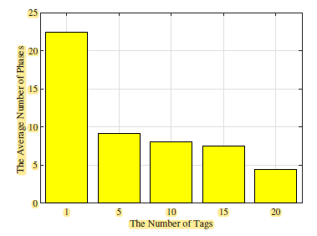
Impact of the Number of Tags
Here we employ 1, 5, 10, 15, and 20 tags in the interrogating area to mimic a multiple-tag environment.
When 20 tags are within the interrogation area, the average number of available phase samples drops to 4.38.

Slide 19
Conclusion
To mitigate the effect of missing phases, a tensor completion based method was employed to restore the missing phases.
The RFThermometer system also employed Gaussian Process to construct a phase-temperature map with the phases restored by tensor completion in the offline stage, and a DTW based greedy method to estimate the unknown temperature in the online stage.
The experimental results showed that RFThermometer was capable of building reliable phase-temperature maps with only a small amount of phase measurements, and that tensor completion effectively improved the temperature estimation precision.

Slide 20
References
[1] J. Zhang, Y. Lyu, J. Patton, S. C. Periaswamy, and T. Roppel, “BFVP: A probabilistic UHF RFID tag localization algorithm using Bayesian filter and a variable power RFID model,” IEEE Transactions on Industrial Electronics, vol. 65, no. 10, pp. 8250–8259, Oct. 2018.
[2]S. Pradhan, E. Chai, K. Sundaresan, L. Qiu, M. A. Khojastepour, and S. Rangarajan, “RIO: A pervasive RFID-based touch gesture interface,” in Proc. ACM MobiCom’17, Snowbird, UT, Oct. 2017, pp. 261–274.
[3]X. Wang, C. Yang, and S. Mao, “SparseTag: High-precision backscatter indoor localization using sparse RFID tags array,” pp. 1–9, preprint, currently under review.
[4]J. Zhang, Z. Yu, X. Wang, Y. Lyu, S. Mao, S. C. Periaswamy, J. Patton, and X. Wang, “RFHUI: An intuitive and easy-to-operate human-UAV interaction system for controlling a UAV in a 3D space,” in Proc. EAI MobiQuitous 2018, New York City, NY, Nov. 2018, pp. 1–8.
[5]J. Zhang, Z. Yu, X. Wang, Y. Lyu, S. Mao, S. Periaswamy, J. Patton, and X. Wang, “RFHUI: An RFID based human-unmanned aerial vehicle interaction system in an indoor environment,” Elsevier Digital Communications and Networks Journal, 2019.

